Slide 1
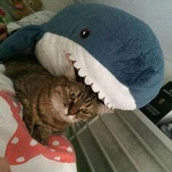
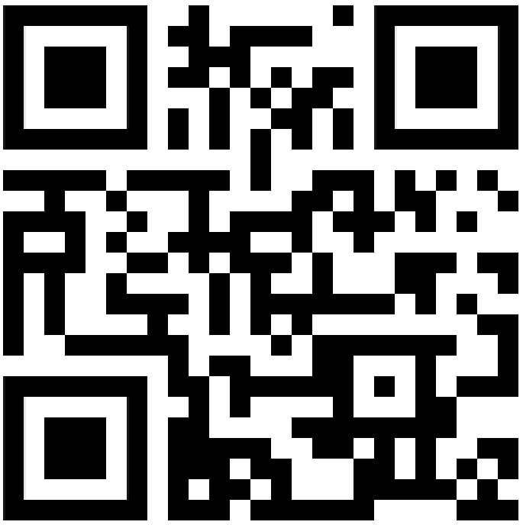
Zayd O'Donovan
CV/Portfolio/Resume
Combined
https://zayd099.carrd.co
The following CV was last updated at:
2024-11-22 16:10:04

Slide 2
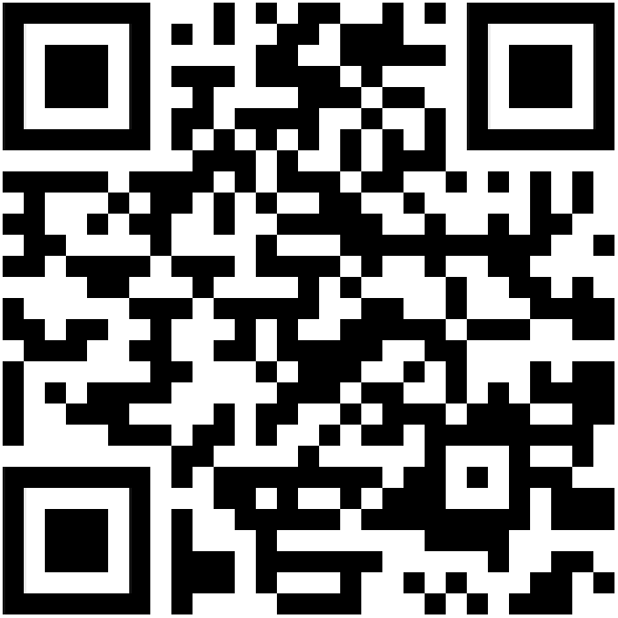
Zayd O'Donovan
Introduction
Hi! I'm Zayd!
This is my very first CV, and I'm tracking myself up for a part time job, or a job of any kind that I'm fit for, ideally I'm aiming for retail, or maybe a coffee barista, or to work in some little shop or something, you get what I'm saying hehe.
I also believe that I could become the very best retailer or barista guy at the till serving those customers! (read my skills. Page 4 please 🙄).
Currently ongoing:
Events, projects, situations, currently happening in my life, such as education, projects, freelance, side work, anything alone those lines, can be found here on my personal website:
https://zayd099.carrd.co/#currentlyongoing
1

Slide 3
Zayd O'Donovan
Basic information about me:
Nicknames: Zed, Z, Divided, Divide, Angel, Death.
Pronouns: any pronouns (he/him preferred)
Gender: Cisgender Male
Date of birth: 23/06/2009
Age: 15
Languages: English UK, English US, English Canadian.
Country: United Kingdom (UK)
Region: Wales
City: Cardiff
Postal Code/ZIP Code: CF119NY
House Address: 14 Springfield Place
House Number: 14
My website is more up-to-date than my CV, for the latest most up-to-date information,
check out my website: www.zayd099.carrd.co
2

Slide 4
Zayd O'Donovan
Index
Pages: 12
All Pages: 19 (including sub pages)
1: Introduction (1)
2: Basic information about me (1)
3: Index (1)
4: Skills (7)
5: Education (1)
6: Experiences and quests (1)
7: Qualifications and certifications (1)
8: Awards and honors (1)
9: Stuff I do (2)
10: Socials and contact info (1)
11: Hobbies and interests (1)
12: Additional (1)
13: Leaving note :3 (1)
Feel free to take a look at my CV in whatever order you'd like to do so in.
My website is more up-to-date than my CV, for the latest most up-to-date information,
check out my website: www.zayd099.carrd.co
3

Slide 5

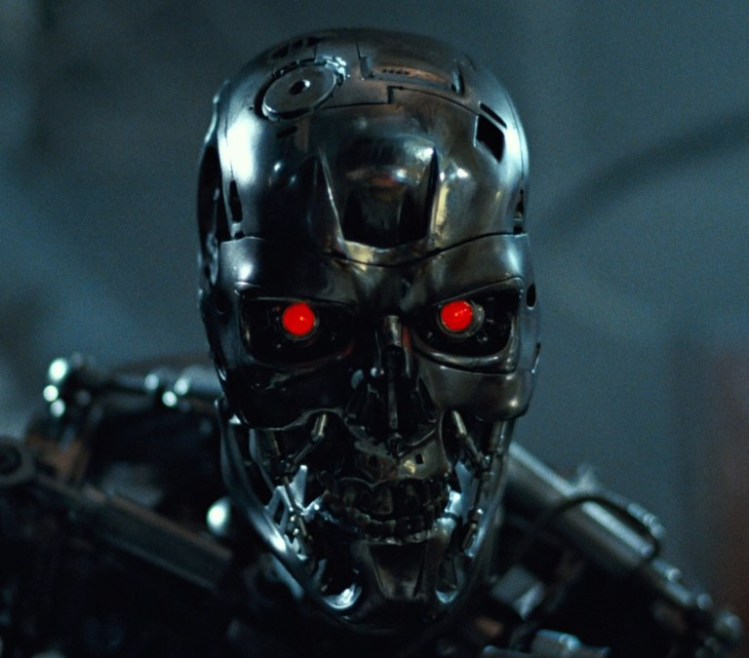

Zayd O'Donovan
Skills
Intermediate Level Python Programming
(3+ years worth of experience)
Intermediate Level AI Prompting and AI Manipulation/Exploitation
(3+ years worth of experience)
Intermediate Level Web Design
(1+ years worth of experience)
4

Slide 6

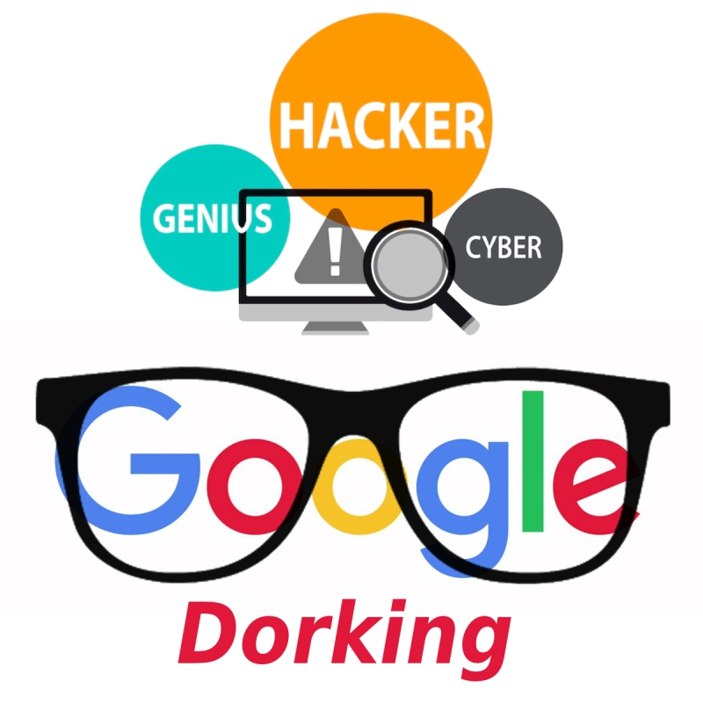



Intermediate Level OSINT
(4+ years worth of experience)
Intermediate Level Web Search Query Manipulation/Exploitation
(3+ years worth of experience)
Intermediate Level Web Scraping
(3+ years worth of experience)
Startup Beginner Skills in Web Development
(1+ years worth of experience)
Python Flask | Beginner Level
(3+ years worth of experience)

Slide 7

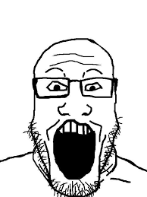
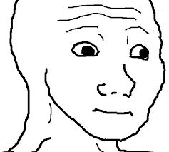

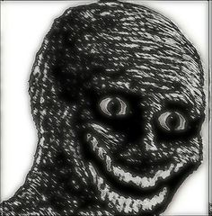
Specialist Level | Creeping people out
(15+ years worth of experience)
Specialist Level | Being weird and creepy
(15+ years worth of experience)
Specialist Level | Making people feel uncomfortable
(15+ years worth of experience)
Specialist Level: Making people feel disturbed
(15+ years worth of experience)
Specialist Level | Causing people to develop homicidal thoughts due to how annoying I can be
(15+ years worth of experience)

Slide 8
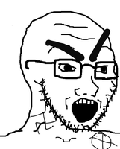
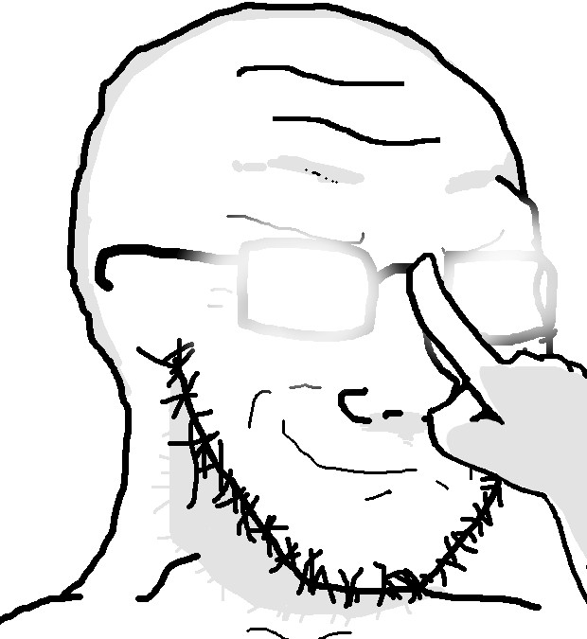
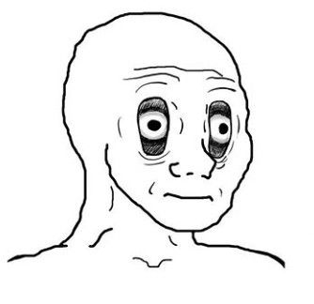

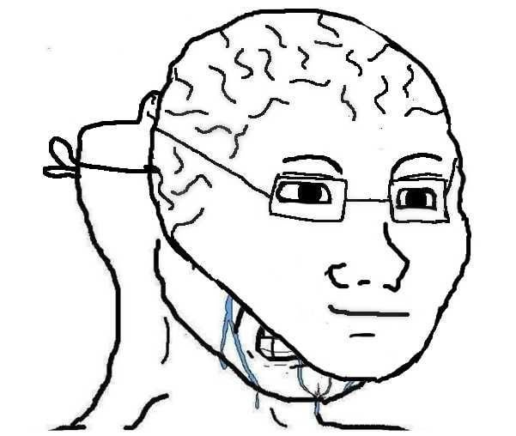
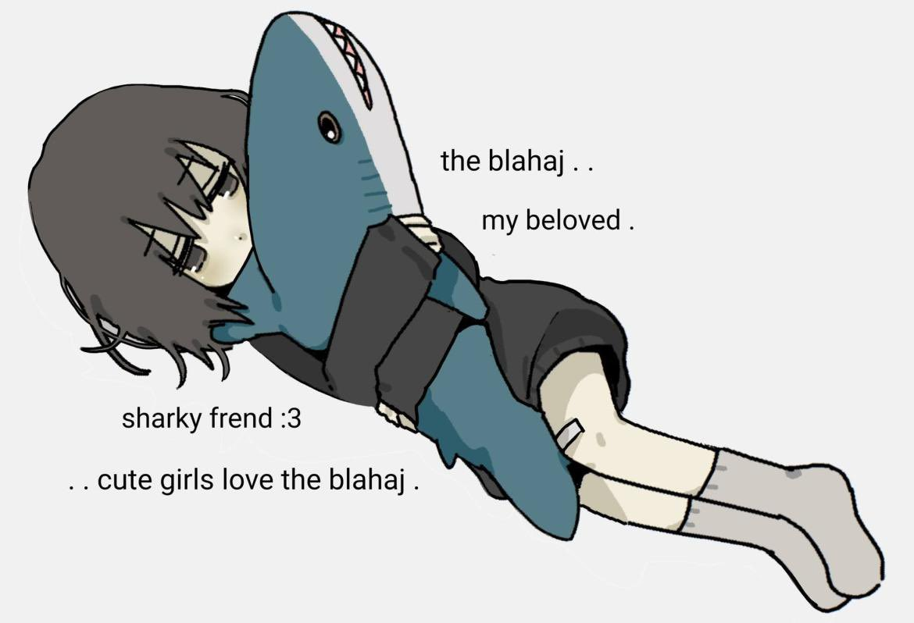
Specialist Level | Pissing people off
(15+ years worth of experience)
Specialist Level | Being unpredictable
(15+ years worth of experience)
Specialist Level | Putting people in shock reactions and surprises
(15+ years worth of experience)
Specialist Level | Escaping and evading problems instead of dealing with them
(15+ years worth of experience)
Specialist Level | Cuddling blahajs
(2+ years worth of experience)

Slide 9
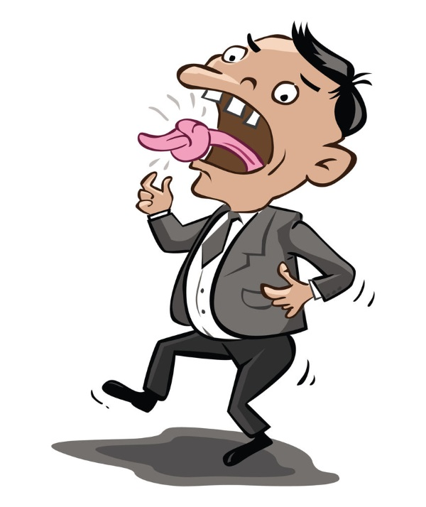
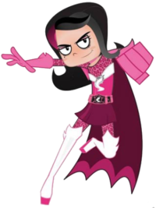
Specialist Level | Stuttering
(15+ years worth of experience)
Specialist Level | Problem solving
(15+ years worth of experience)
Specialist Level | Being Zayd
(15+ years worth of experience)
Specialist Level | REALLY LOUD SUPER SONIC TURBO MEGASCREAMING
(15+ years worth of experience)

Slide 10
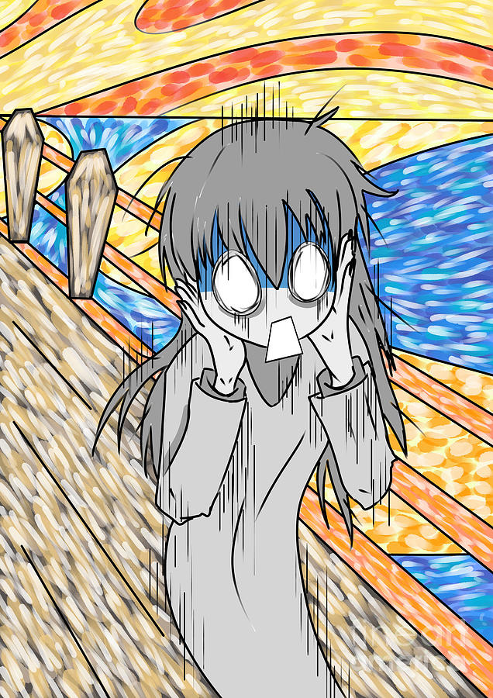
Emotional Intelligence (EQ)
(15+ years worth of experience)
🌈
Therapeutic and Counseling Skills
(15+ years worth of experience)
Interpersonal and Support Skills
♥️
(15+ years worth of experience)
😇
Leadership and Guidance
(15+ years worth of experience)
Patience and Calmness
(15+ years worth of experience)
Specialist Level | Squeaky Voice
(15+ years worth of experience)

Slide 11




Video Editing | Advanced Level
(7+ years worth of experience)
Game Development | Intermediate Level
(1+ years worth of experience)
Graphics Design | Intermediate Level
(5+ years worth of experience)
PowerPoints and Presentations | Advanced Level
(2+ years worth of experience)

Slide 12
Zayd O'Donovan
Education
Studied at Cantonian High School.
2020-2023
My website is more up-to-date than my CV, for the latest most up-to-date information,
check out my website: www.zayd099.carrd.co
5

Slide 13
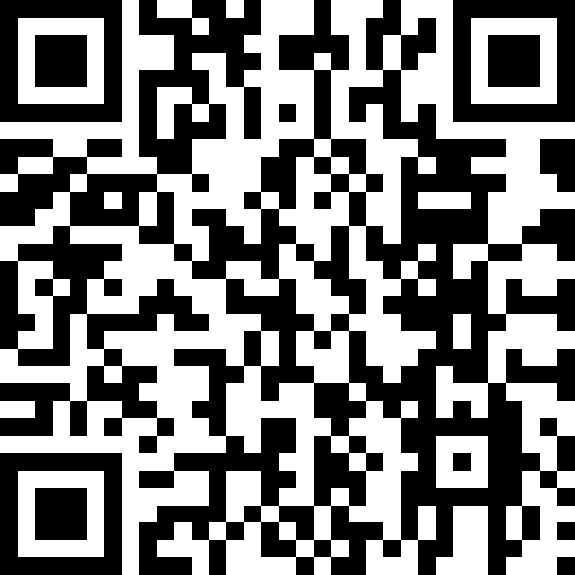
Zayd O'Donovan
Experiences and Quests
Wales Millenium Centre (WMC)
Over at Wales Millenium Centre (WMC), I've been introduced to various different creative fields and pathways, such as creative VR, event security, event management, creative writing, film making, video editing, flip books, and I've even had been introduced to It's My Shout and BBC.
If you think that's cool, I've done so much more at WMC!
Scan here to learn more:
www.divided099.github.io/divided/WMC-All-Weeks-_Walkthrough_.html
6

Slide 14
Zayd O'Donovan
Qualifications and Certifications
None.
My website is more up-to-date than my CV, for the latest most up-to-date information,
check out my website: www.zayd099.carrd.co
7

Slide 15
Zayd O'Donovan
Awards and Honors
None.
My website is more up-to-date than my CV, for the latest most up-to-date information,
check out my website: www.zayd099.carrd.co
8

Slide 16



Zayd O'Donovan
Stuff I do:
Blog Article Writing:
I write online blog posts, about tech, finance, cyber security, console modding.
Content Creation:
I produce and create content for pretty much all the well known social media platforms out there, and the even the less known smaller platforms, my content is often associated with video games, memes, online dramas, game modding, console modding, and a lot more, my content tends to shift into a lot of different things, and it's hard to pin-point what I do exactly.
Discord Server Owner/Admin/Mod:
I've been part of many Discord servers in the past, as either admin, mod, or many other roles, and have even been the owner.
My website is more up-to-date than my CV, for the latest most up-to-date information,
check out my website: www.zayd099.carrd.co
9

Slide 17


Doom Modding:
I make mods for Doom 1 and Doom 2, the original video games.
Web Automation Programs:
I tend to make automation scripts and programs, that tend to use programming frameworks such as: Python, CURL, BASH, and many more.
I've coded and scripted many automation programs for specific websites, I once even tried to make one to automatically apply for jobs for me with Python and CURL, you might be able to find some of these on my GitHub, but keep in mind, most of this work isn't publicly documented, meaning only I have access to them.
My website is more up-to-date than my CV, for the latest most up-to-date information,
check out my website: www.zayd099.carrd.co

Slide 18
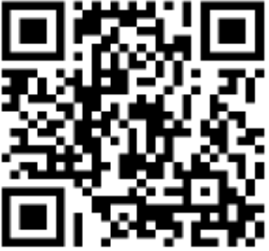
Zayd O'Donovan
Socials and contact info
Personal Website: https://zayd099.carrd.co
Refs: https://zayd099.carrd.co/#cvrefs
Linktree: https://linktr.ee/cantstopdivided
GitHub: https://github.com/divided099
Medium: https://medium.com/@divided099
YouTube: https://youtube.com/@CantStopDivided
SpaceHey: https://spacehey.com/divided099
DoomWorld: https://doomworld.com/user/51175-divided2
GBATemp: https://gbatemp.net/members/divided099.695336
Personal Discord Server: https://discord.gg/5BvCVv3yy9
Contact me:
Facebook: https://facebook.com/profile.php?id=100083365003168
Telegram: https://t.me/divided099
Discord: https://discord.com/users/1155952637674541147
Reddit: https://reddit.com/user/BenRemedy
Snapchat: https://snapchat.com/t/5PJRrQW4
Phone Number: +447842535744
Email Address: ZaydZOD@proton.me
Secondary Email Address: ZaydOD@mail.com
This page is also viewable on my website:
https://zayd099.carrd.co/#cv_page9_1
10

Slide 19
Zayd O'Donovan
Hobbies and interests
Prefer not to say.
My website is more up-to-date than my CV, for the latest most up-to-date information,
check out my website: www.zayd099.carrd.co
11

Slide 20
Zayd O'Donovan
Additional
Some of my projects: https://zayd099.carrd.co#someofmyprojects
All of my projects: https://zayd099.carrd.co#allofmyprojects
My website is more up-to-date than my CV, for the latest most up-to-date information,
check out my website: www.zayd099.carrd.co
12

Slide 21
Zayd O'Donovan
Leaving note
To the person that didn't properly read my CV with the same amount of enthusiasm I read it to myself in, I hope you have an amazing day, and I hope you can grant me the job.
In case I haven't told you yet, my name is Zayd, and you can refer to me as any of the nicknames provided on Page 3. I also have social anxiety, so it would be very nice if you could keep that in mind.
Thank you so much for giving me a chance, by reading through all of this shit!
Enjoy your day, sir or mam or something more you :3
13

Slide 22
Zayd O'Donovan
773
https://zayd099.carrd.co

